Slide 1
Colocalization
Todd Fallesen

Slide 2
Outline
Colocalization
What even is it
Pixel Based
Pearsons’s
Spearman’s
Manders
Controls
Object Based
Basically, CellProfiler
Reproducibility/Methods writing
2
Notes:
Please feel free to ask questions

Slide 3
What do we mean by Colocalization?
People mean different things by Colocalization.
Do different markers show up in the same cell?
Do objects overlap?
Do proteins interact?
Is a protein inside a cellular structure?

Slide 4
Color Registration

Slide 5
Pixel based Colocalization assessment is often visual
Simplest Case:
Merge two fluorescence pseudo-colored images
Assess whether different wavelengths are present in same pixels
E.g. Red + Green = Yellow
Problem:
Intermediate color (e.g. yellow) only visible if probes overlap in similar proportions

Slide 6
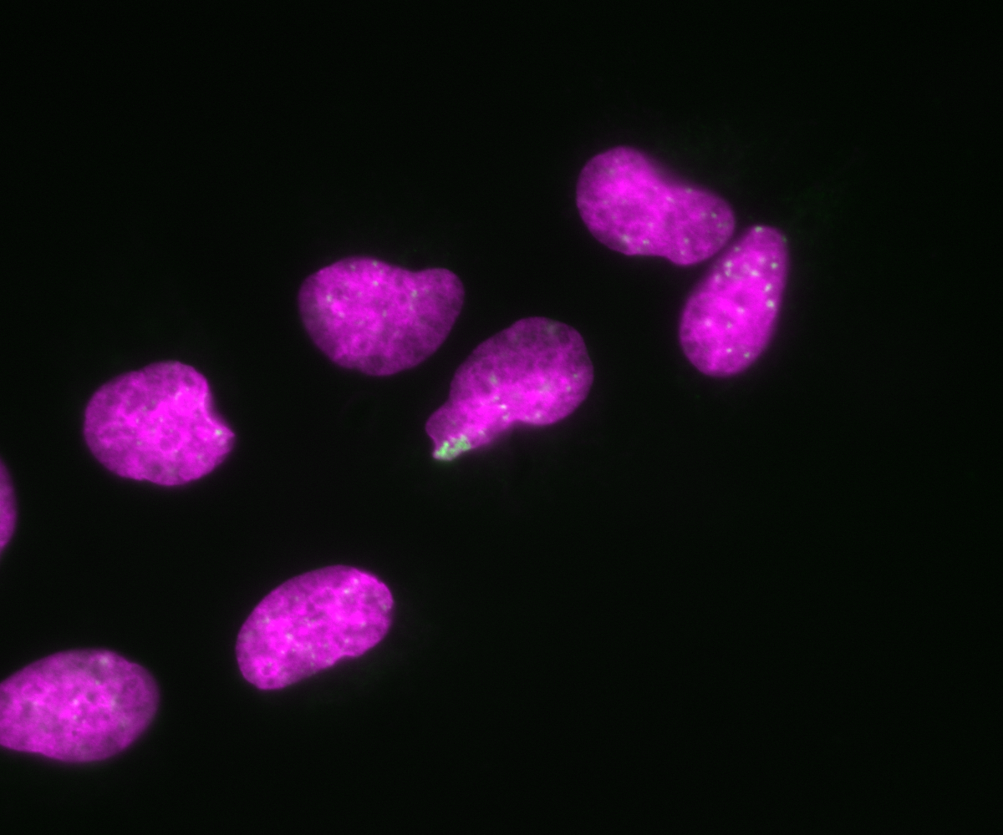
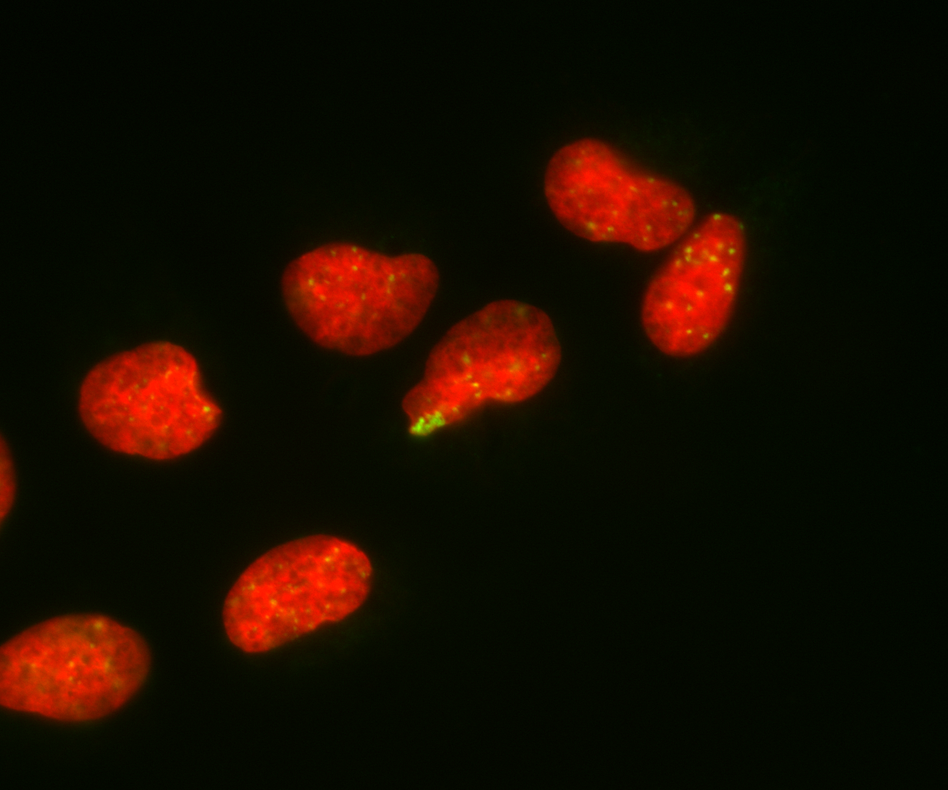
Color assessment doesn’t always work
Colors don’t always work. We can’t even see the white in some areas.

Slide 7

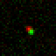
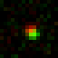
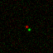
Co-Occurance never actually happens!
Confocal
There is no such thing as “colocalization”!
Deconvolved Widefield
Super-Resolution

Slide 8
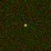
what if DOTs overlap at max resolution?
Fluorophores reside within same volume.
Volume at least one order of magnitude larger than protein complexes

Slide 9

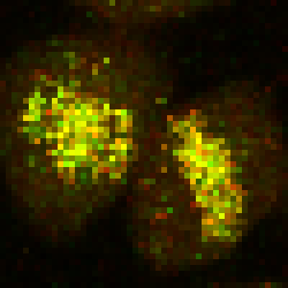
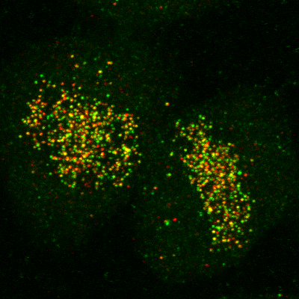
Correlation is not causation
Colocalisation does not imply interaction
Non-colocalisation probably implies no interaction
Dividing line between colocalisation and non-colocalisation is arbitrary
Extent of colocalisation decreases with increasing spatial resolution
Demmerle et al., Nat Protocols, 2017
Relative Localisation
Correlation Analysis

Slide 10
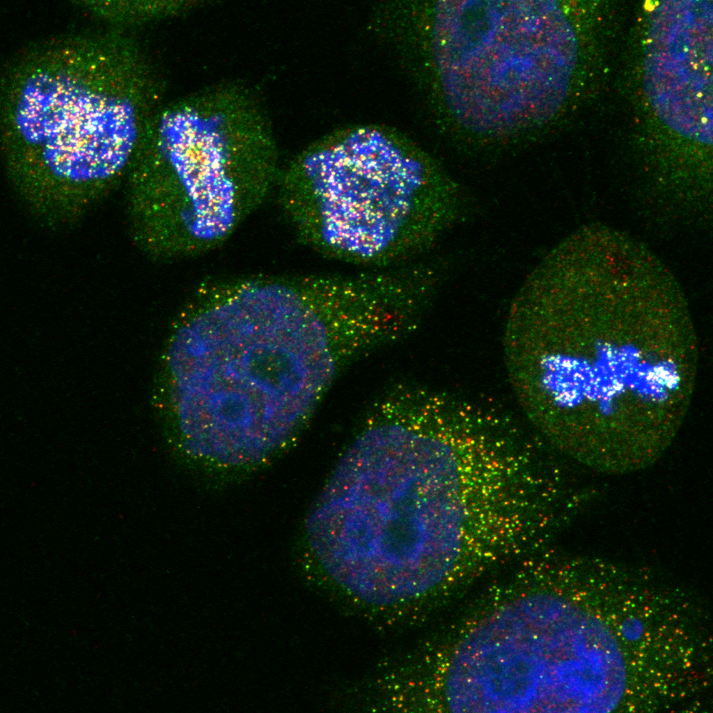
Two criteria must be met:
Co-occurrence - spatial overlap of probes
Correlation - probes are co-distributed
Distribution may overlap, but not proportionally
DAPI will overlap with nuclear proteins, but will unlikely be proportional

Slide 11
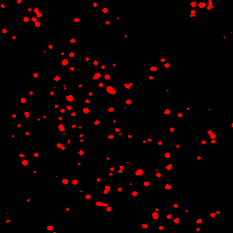
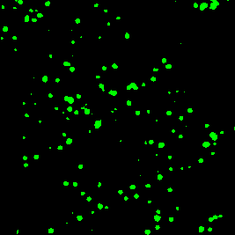
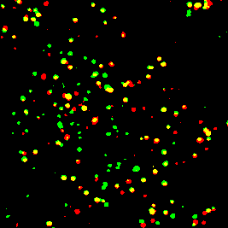
Intensity-based correlation coefficients
Pearsons
Analysis of signal correlation
Spearmans
Similar to Pearsons
Less sensitive to outliers
Manders
Analysis of signal overlap

Slide 12
Pearsons coefficient
Measures the linear correlation between two signals, looking at intensity levels of the two signals are on a pixel-by-pixel basis.
Range from -1 to 1, -1 is completely negatively correlated, +1 is correlated completely
Very sensitive of ROI placement. Imagine a single pixel, vs different ROI
Drawing an ROI is very difficult to automate, especially in 3D
Notes:
Kinesin on Microtubules would have a manders of 1, all kinesin is on microtubules, but not all microtubules are kinesin
Microtuubule on kinesin channel would have a very low manders.

Slide 13





Pearson’s correlation coefficient
$$P_{cc}=\frac{\sum_{i}{(R_{i}−\overline{R})×(G_{i}−\overline{G})}}{\sqrt{\sum_{i}{{(R_{i}−\overline{R})}^{2}×}\sum_{i}{{(G_{i}−\overline{G})}^{2}}}}$$
$$\sum_{i}{(R_{i}−\overline{R})×(G_{i}−\overline{G})}$$
$\overline{R}=$ Mean red intensity in whole image
$R_{i}−\overline{R}=$ Difference between each red pixel and the mean red intensity
$$\sqrt{\sum_{i}{{(R_{i}−\overline{R})}^{2}×}\sum_{i}{{(G_{i}−\overline{G})}^{2}}}$$
$\sum_{i}{{(R_{i}−\overline{R})}^{2}=}$ Variance in red signal
$$σ_{R+G}=\sqrt{{σ_{R}}^{2}×{σ_{G}}^{2}}$$
The coefficient is normalised to the standard deviation across the two channels to ensure that values range from -1 to +1

Slide 14


Pearson’s correlation coefficient
-74.4 | X | -74.5 | = | 5543
74.4 | X | 130.1 | = | 9683
65.9 | X | 15.6 | = | 1026
-65.9 | X | -71.2 | = | 4690
113.3
Mean: 113.1
 |  |  |  | 20944
47.8 | 252.4
137.9 | 51.1
-74.5 | 130.1
15.6 | -71.2
5535 |  | 5550
4343 |  | 16926
4343 |  | 243
5535 |  | 5069
122.3
Mean: 122.3
19751 |  | 27788
$$P_{cc}=\frac{\sum_{i}{(R_{i}−\overline{R})×(G_{i}−\overline{G})}}{\sqrt{\sum_{i}{{(R_{i}−\overline{R})}^{2}×}\sum_{i}{{(G_{i}−\overline{G})}^{2}}}}$$
If two targets are functionally related, their abundances will be predictably related
$$P_{cc}=\frac{20944}{\sqrt{19751 × 27788}}=0.894$$

Slide 15
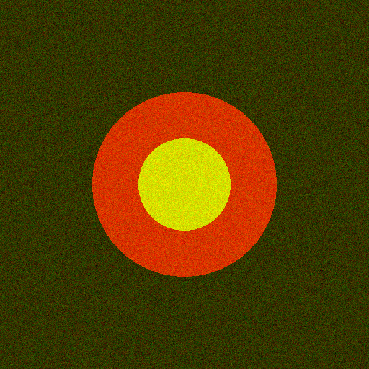
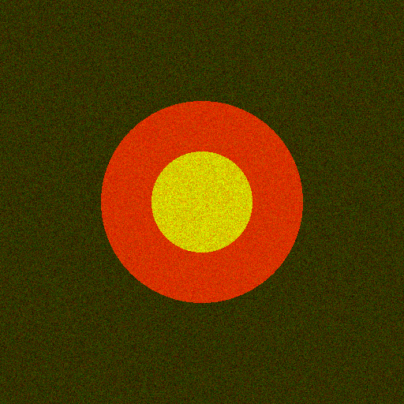
Noise results in “Less” correlation
P_{cc} = 0.41
P_{cc} = 0.33
Sample can exhibit high co-occurrence, but low correlation

Slide 16
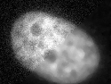
Filtering suppresses Noise
But information is lost!

Slide 17
Pearson’s: Pros & Cons
PROS
CONS
Easy to measure
Broadly applicable
Independent of signal levels
Same amount of signal overlap can have dramatically different P_{CC} values
Intermediate values difficult to interpret
Background pixels artificially inflate P_{CC} values
Empty areas within cells have similar effect
Depends on linear relationship between probe intensities

Slide 18
Spearman’s correlation coefficient
Pearson’s skewed by non-linearity, such as outliers
Spearman’s similar to Pearson’s, but compares ranks rather than values
Red | Green | Rank Red | Rank Green
96 | 93 | 6 | 7
177 | 209 | 3 | 3
41 | 30 | 10 | 10
43 | 94 | 9 | 6
500 | 10000 | 1 | 1
112 | 165 | 4 | 4
102 | 234 | 5 | 2
194 | 75 | 2 | 8
79 | 104 | 7 | 5
64 | 52 | 8 | 9
P_{c} = 0.9
S_{c} = 0.1

Slide 19
Both measure poorly the quantity that is typically at the heart of most analyses of colocalization in cell biology:
The fraction of one family of objects that localizes with another.

Slide 20
Manders coefficient
Overlapping fraction method
Set a threshold for channel 1 and channel 2
The pixels stay the same value if above the threshold, 0 otherwise
Then calculate Manders coefficients M1 and M2
M1 is the fraction of channel 1 that co-occurs with channel 2
M2 is the fraction of channel 2 that co-occurs with channel 1
Manders values are not equal between M1 and M2
Manders doesn't equal volume overlap
Notes:
Kinesin on Microtubules would have a manders of 1, all kinesin is on microtubules, but not all microtubules are kinesin
Microtuubule on kinesin channel would have a very low manders.

Slide 21
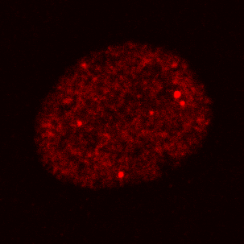
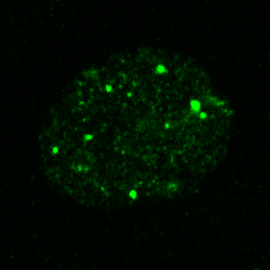
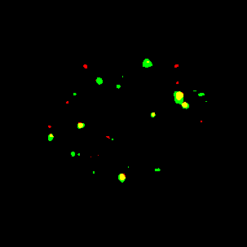
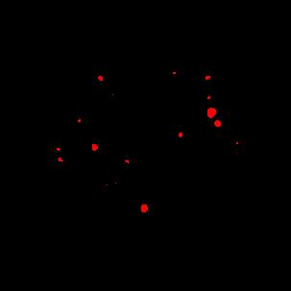
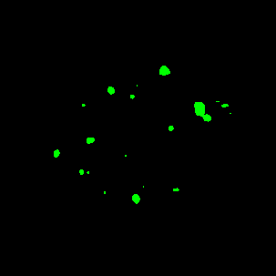
M_{red-green} = 0.59
M_{green-red} = 0.68

Slide 22



Mander’s coefficient
Overlap Coefficient:
$$M_{OC}=\frac{\sum_{i}{(R_{i}×G_{i})}}{\sqrt{\sum_{i}{{R_{i}}^{2}×}\sum_{i}{{G_{i}}^{2}}}}$$
Independent of signal proportionality
Sensitive to co-occurrence, the fraction of pixels with signals from both channels
Colocalisation Coefficient:
$$M_{1}=\frac{\sum_{i}{R_{i,colocal}}}{\sum_{i}{R_{i}}}$$
$$M_{2}=\frac{\sum_{i}{G_{i,colocal}}}{\sum_{i}{G_{i}}}$$
Problem: Image must contain meaningful “zero” values.

Slide 23
Controls
Correlation coefficients mean little in isolation
Analyses should include positive and negative controls
But, control samples may not exist
Practical alternative: generate a “random” distribution by scrambling, translation or rotation.

Slide 24
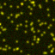
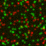
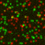
Generating controls
Original
Rotated 90°
Randomised
P = 0.95
P = -0.06
P = 0.00

Slide 25
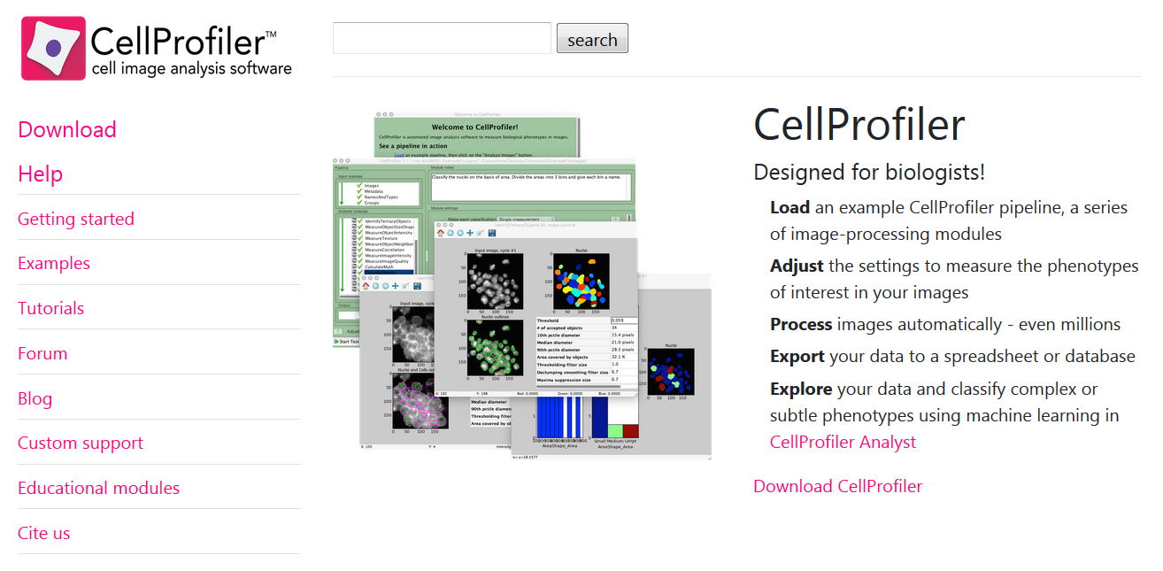
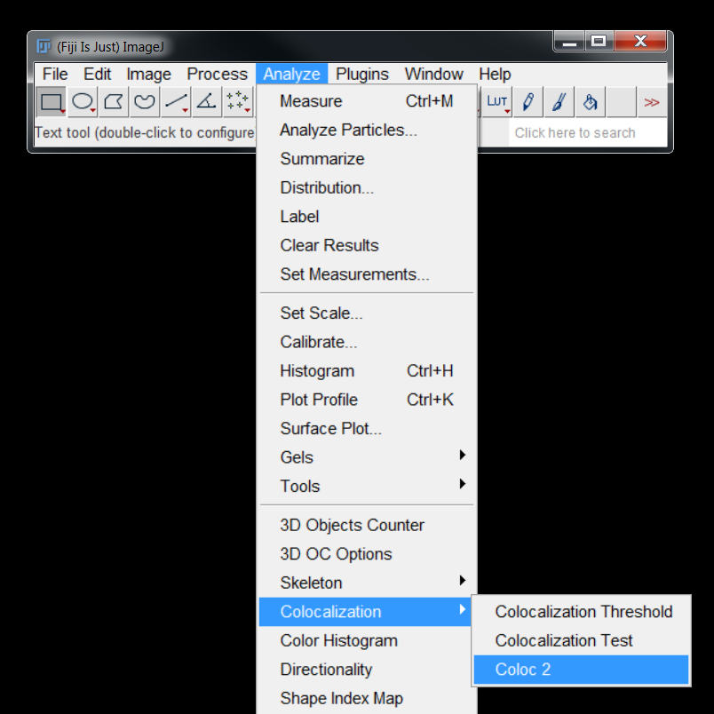
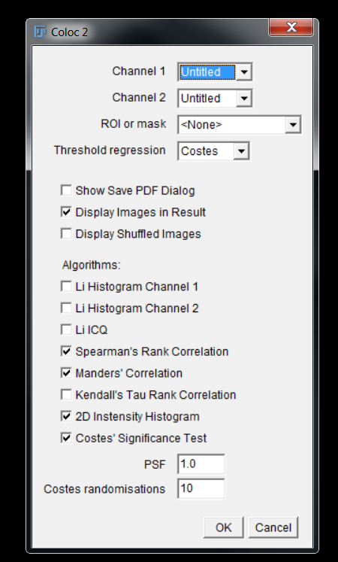
COLOC2 – FIJI Plugin for colocalisation analysis

Slide 26
Object based Colocalization

Slide 27
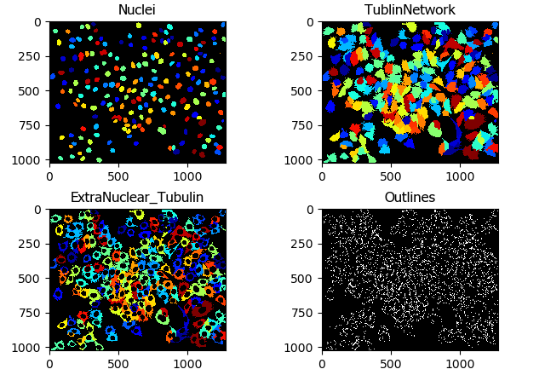
Overview
CellProfiler Operates on Objects
Primary objects are easily segmentable objects we start with
Secondary objects grow from Primary objects
Tertiary objects are the subtraction of primary objects from secondary objects
Objects are masks over any channel
Almost all measurements are done on objects

Slide 28
Usage tips
The easiest way to use CellProfiler is in GUI form, with all your images separated.
It is harder to work with image stacks, or hyperstacks.
Separate z-stacks into image sequences
Separate time-series out as well.
CellProfiler isn’t easy to use in 4D.

Slide 29
Usage tips
The easiest way to use CellProfiler is in GUI form, with all your images separated.
It is harder to work with image stacks, or hyperstacks.
Separate z-stacks into image sequences
Separate time-series out as well.
CellProfiler isn’t easy to use in 4D.

Slide 30
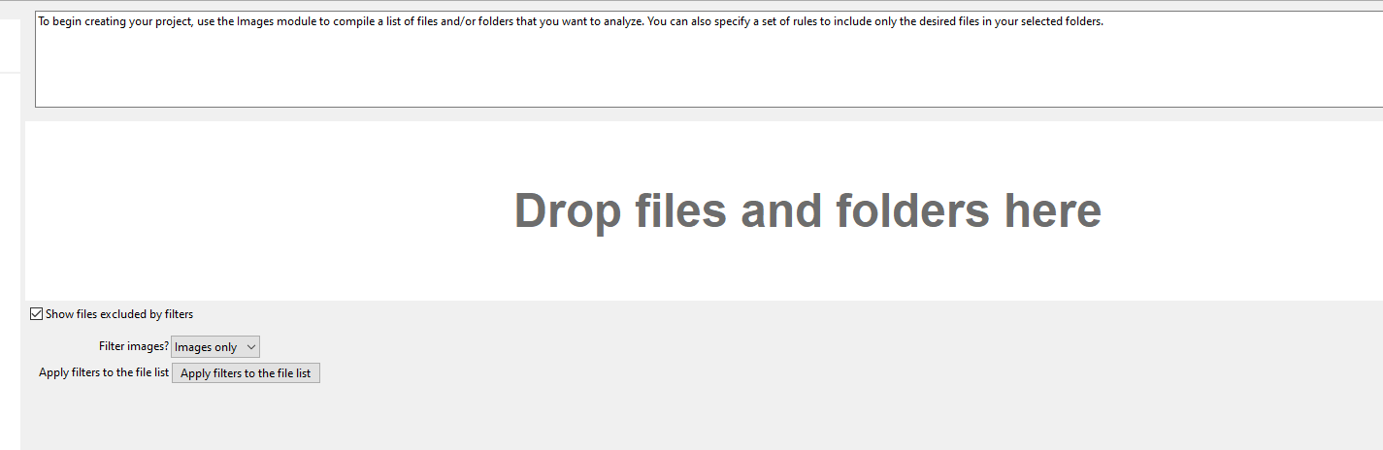
Loading Images
Drop files into the dialog box here

Slide 31
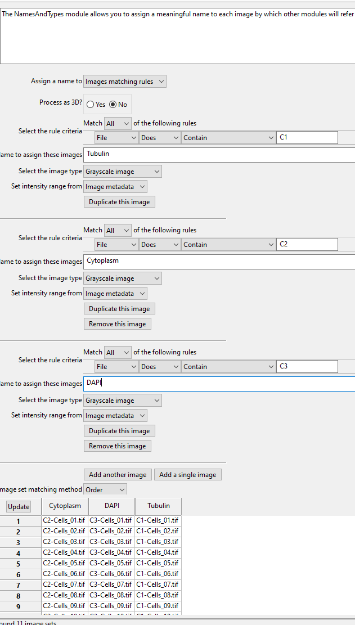
Image Naming
Use rules to differentiate between images
Make sure that each channel has a unique identifier
Usually use the rules ‘Does’ or ‘Does not’ contain an expression. Avoid regular expressions.
Click update and make sure that everything is lined up properly
Numbering goes :
1,10,11,12,….19,2,20,21…….29,3,30…
Always number files 01,02, 03….10,11. etc.
If you will have more than a hundred images
001, 002, 003, ….010….099, 100;

Slide 32
Objects
CellProfiler is a powerful segmentation tool. The result of segmentation are objects, which are the backbone of all subsequent processing.
Objects can be extended to find secondary or tertiary objects
Objects can be measured over multiple channels (i.e. use a nuclear object as a mask to measure the signal of another channel inside nuclei).
Objects can be merged, split, eroded, filtered by measurements
Objects can be tracked

Slide 33
Primary Objects
Primary objects are those that are found from an image without any additional information.
Easily detectable objects, as opposed to confluent cells.
Can be found by image analysis techniques in CellProfiler
Thresholding, watershed, etc.
Can be imported from outside image segmentation
StarDist, Cellpose
IdentifyPrimaryObjects identifies biological objects of interest. It requires grayscale images containing bright objects on a dark background. Incoming images must be 2D (including 2D slices of 3D images); please use the Watershed module for identification of objects in 3D.

Slide 34
Primary Objects
Primary objects are those that are found from an image without any additional information.
Easily detectable objects, as opposed to confluent cells.
Can be found by image analysis techniques in CellProfiler
Thresholding, watershed, etc.
Can be imported from outside image segmentation
StarDist, Cellpose
IdentifyPrimaryObjects identifies biological objects of interest. It requires grayscale images containing bright objects on a dark background. Incoming images must be 2D (including 2D slices of 3D images); please use the Watershed module for identification of objects in 3D.

Slide 35
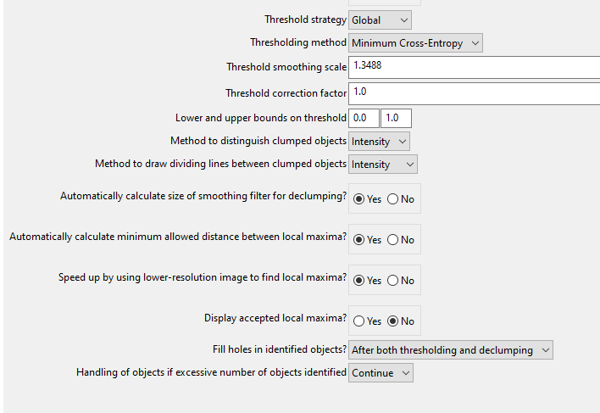
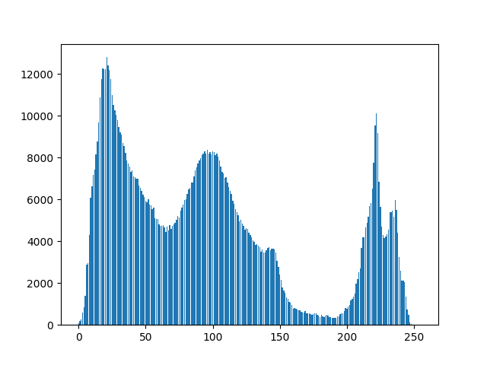
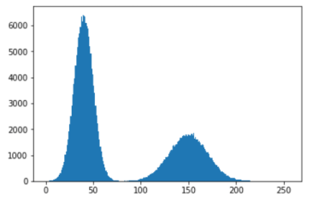
Thresholding
Global is more useful. If doing adaptive, then do illumination correction
Play with the thresholding method. The Otsu method lets you do a three class thresholding.
Declumping by intensity is useful if there is good demarcation between objects
Declumping by shape is useful if there is curvature between the objects

Slide 36
Secondary Objects
Secondary objects use a primary object for reference in detection, i.e. a nuclei to start, and then propogate out to find cell boundary in cytoplasm
Tertiary objects are just secondary objects with the primary object removed (i.e. cytoplasm without the nuclei)

Slide 37
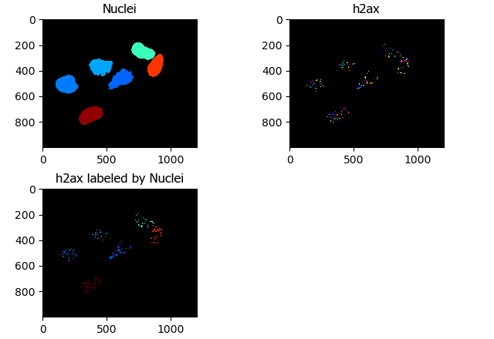
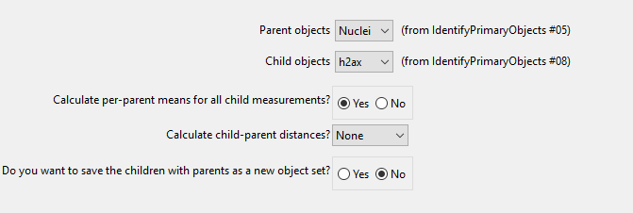
Relating Objects
Relating objects gives a child-parent relationship between two sets of objects.
This would be for something akin to RNAScope, where you would want to count the number or intensity of labelled RNA inside a nucleus

Slide 38
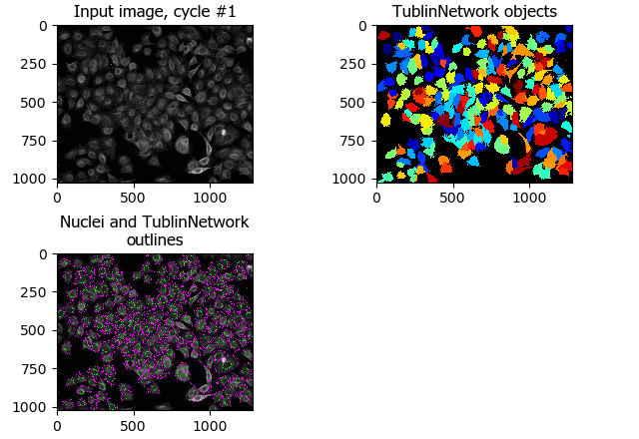
Relating Objects vs Secondary Objects
Secondary objects ‘grow’ from primary objects
Related objects are ‘inside’ other objects.
The two related objects can both be primary objects.
You can’t relate a secondary object set to the primary object set it grew from

Slide 39
Object Measurements
You can measure a variety of parameters of the objects
Intensity
Total
Gradients
Colocalization
Granularity
Texture
Size/Shape properties
Area
Eccentricity
Number of Neighbors
You can plot within CellProfiler, but you can’t save the plots programmatically.

Slide 40
Saving Data
Can export image files and csv files
Can also export databases for CellProfiler Analyst, which is beyond the scope of this class

Slide 41
Task 4
Open the pipeline for Example Speckles and load the data
We’re going to explore this together

Slide 42
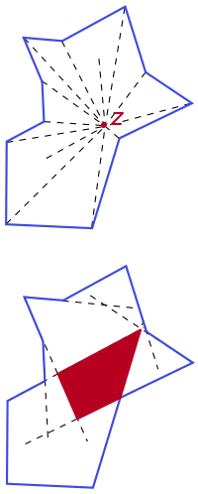
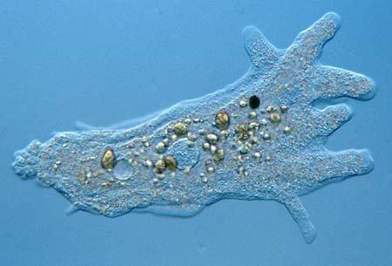
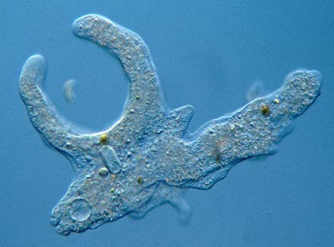
StarDist (or CellPose)
Stardist can only detect objects that are Star-convex: all the points of the perimeter can be reached by rays emanating from a point somewhere in the object.
StarDist is a plugin for FIJI that allows for quick segmentation of star-convex objects (round, nuclear shaped things).
StarDist can’t be run inside CellProfiler, but it’s a great trick to know
Running StarDist on a DAPI channel, and bringing those results in to CellProfiler as a separate image channel allows for easy nuclear segmentation

Slide 43
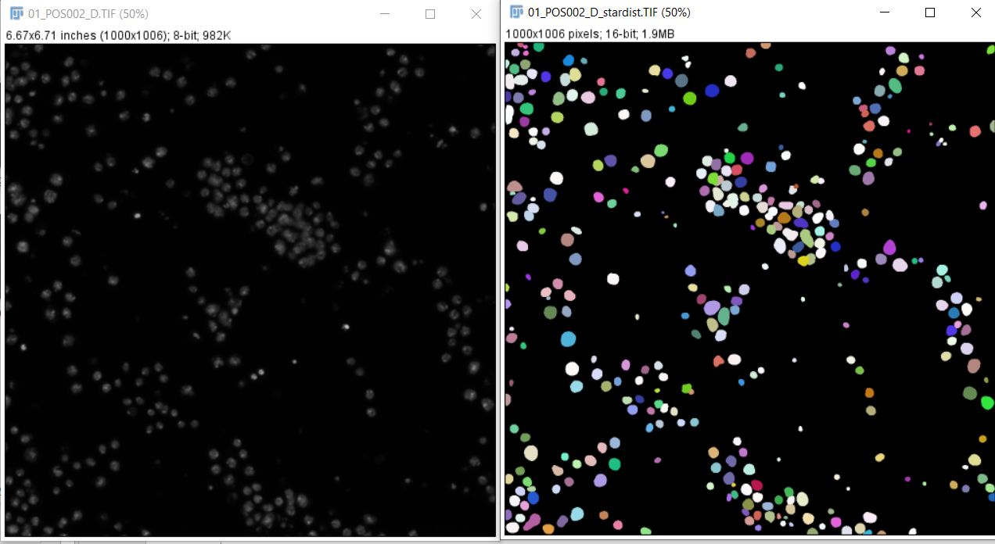
StarDist in FIJI
Need to add the CSBDeep and StarDist libraries
Run stardist on a nuclear image, and save the resulting prediction image as a tiff. The ‘pixel intensity’ of each nuclei is the nuclear ID label

Slide 44
Macros Included
split_channel_multiple_series_and_rename.ijm – split images into single channel images
stardist_process_folder.ijm – run stardist on a specified channel in a folder of split images

Slide 45
Documentation
Image analysis is like any other science experiment.
Document what you do
Document what experimental parameters you vary
Record your steps!
Make it reproducible
FIJI Macro Recorder
Write code from data to figure! Have it reproducible

Slide 46
Extra help
https://www.ncbi.nlm.nih.gov/pmc/articles/PMC3074624/
https://imagej.net/imaging/colocalization-analysis

